Slide 1
COMP 4500
Week 1 - Wednesday

Slide 2
Last time
Course overview
Big Theta of code

Slide 3
Questions?

Slide 4
Assignment 1

Slide 5
Logical warmup
You come to a fork in the road
Two men stand beneath a sign that reads:
  Ask for the way, but waste not your breath
  One road is freedom, the other is death
  Just one of the pair will lead you aright
  For one is a Knave, the other a Knight
What single yes-or-no question can you ask to determine which fork to take?

Slide 6
Back to Big Theta

Slide 7
Steps on steps on steps
What's the Big Theta bound if n is n?
int counter = 1;
for(int i = 1; i <= n; ++i) {
for(int j = 0; j < counter; ++j)
System.out.println("$");
counter *= 2;
}

Slide 8
Switch it up
What's the Big Theta bound if n is n?
int counter = 1;
for(int i = 1; i <= n; ++i) {
for(int j = 0; j < n/counter; ++j)
System.out.println("$");
counter *= 2;
}

Slide 9
Back to your roots
What's the Big Theta bound if n is n?
for(int i = 0; i*i < n; ++i)
for(int j = 0; j < n; ++j)
System.out.println("%");

Slide 10
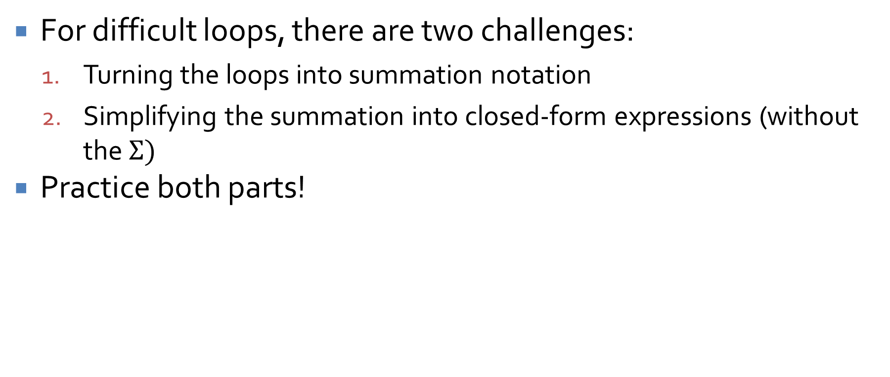
Finding the Big Theta of loops
For difficult loops, there are two challenges:
  Turning the loops into summation notation
  Simplifying the summation into closed-form expressions (without the $Σ)$
Practice both parts!

Slide 11
Proofs

Slide 12
The nature of a proof
A proof is a tool to convince ourselves (and others) that a statement is completely true
A direct proof starts with a set of true statements:
  Axioms (things that are always true)
  Premises (things that we assume are true for this proof)
Then, you take those true things and generate more true statements using definitions, the laws of mathematics, and logic
When you're able to generate the conclusion you wanted to prove, you're done!

Slide 13
Universal quantification
The universal quantifier ∀ means "for all"
The statement "All DJs are mad ill" can be written more formally as:
∀x ∈ D, M(x)
  Where D is the set of DJs and M(x) denotes that x is mad ill
We will often want to prove that if something has some property, it will have some other property
For example:
  ∀x ∈ D, B(x) → S(x)
  Imagine that B(x) means that x breaks it down funky style and that S(x) means that x stacks cheddar

Slide 14
Existential quantification
The existential quantifier ∃ means "there exists"
The statement "Some emcee can bust a rhyme" can be written more formally as:
∃y ∈ E, B(y)
  Where E is the set of emcees and B(y) denotes that y can bust a rhyme

Slide 15
Negating quantified statements
When doing a negation, negate the predicate and change the universal quantifier to existential or vice versa
Formally:
  ~(∀x, P(x)) ≡ ∃x, ~P(x)
  ~(∃x, P(x)) ≡ ∀x, ~P(x)
Thus, the negation of "Every dragon breathes fire" is "There is a dragon that does not breathe fire"

Slide 16
Proving Existential Statements and Disproving Universal Ones

Slide 17
Proving existential statements
A statement like the following:
∃x ∈ D such that P(x)
is true, if and only if, you can find at least one element of D that makes P(x) true
To prove this, you either have to find such an x or give a set of steps to find one
Doing so is called a constructive proof of existence
There are also nonconstructive proofs of existence that depend on using some other axiom or theorem

Slide 18
Examples
Prove that there is a positive integer that can be written as the sum of the squares of two positive integers in two distinct ways
More formally, prove:
  ∃x, y, z, a, b ∈ Z⁺ such that x = y² + z² and x = a² + b² and y ≠ a and y ≠ b
Suppose that r and s are integers. Prove that there is an integer k such that 22r +18s = 2k

Slide 19
Disproving universal statements
Disproving universal statements is structurally similar to proving existential ones
Instead of needing any single example that works, we need a single example that doesn't work, called a counterexample
Why?
To disprove ∀x ∈ D, P(x) → Q(x), we need to find an x that makes P(x) true and Q(x) false

Slide 20
Examples
Using counterexamples, disprove the following statements:
∀a, b ∈ R, if a² = b² then a = b
∀x ∈ Z, if x ≥ 2 and x is odd, x is prime
∀y ∈ Z⁺, if y is odd, then (y – 1)/2 is prime

Slide 21
Proving Universal Statements

Slide 22
Method of exhaustion
If the domain is finite, try every possible value
Example:
  ∀x ∈ Z⁺, if 4 ≤ x ≤ 10 and x is even, x can be written as the sum of two prime numbers
Is this familiar to anyone?
Goldbach's Conjecture proposes that this is true for all even integers greater than 2

Slide 23
A useful definition
We'll start with basic definitions of even and odd to allow us to prove simple theorems
If n is an integer, then:
  n is even ⇔ ∃ k ∈ Z such that n = 2k
  n is odd ⇔ ∃ k ∈ Z such that n = 2k + 1
Since these are bidirectional, each side implies the other

Slide 24
Generalizing from the generic particular
Pick some specific (but arbitrary) element from the domain
Show that the property holds for that element, just because of that properties that any such element must have
Thus, it must be true for all elements with the property
Example: ∀x ∈ Z, if x is even, then x + 1 is odd

Slide 25
Direct proof
Direct proof uses the method of generalizing from a generic particular, following these steps:
  Express the statement to be proved in the form ∀x ∈ D, if P(x) then Q(x)
  Suppose that x is some specific (but arbitrarily chosen) element of D for which P(x) is true
  Show that the conclusion Q(x) is true by using definitions, other theorems, and the rules for logical inference

Slide 26
Direct proof example
Prove that the sum of any two odd integers is even

Slide 27
Proof by contradiction
In a proof by contradiction, you begin by assuming the negation of the conclusion
Then, you show that doing so leads to a logical impossibility
Thus, the assumption must be false and the conclusion true

Slide 28
Contradiction formatting
A proof by contradiction is different from a direct proof because you are trying to get to a point where things don't make sense
You should always clearly state that it's a proof by contradiction
You will reach a point where you have p and ~p, mark that as a contradiction
If you're doing a proof by contradiction and you actually show the thing you wanted to prove in the first place, it's not a proof!

Slide 29
Proof by contradiction example
Theorem: There is no integer that is both even and odd
Proof by contradiction: Assume that there is an integer that is both even and odd

Slide 30
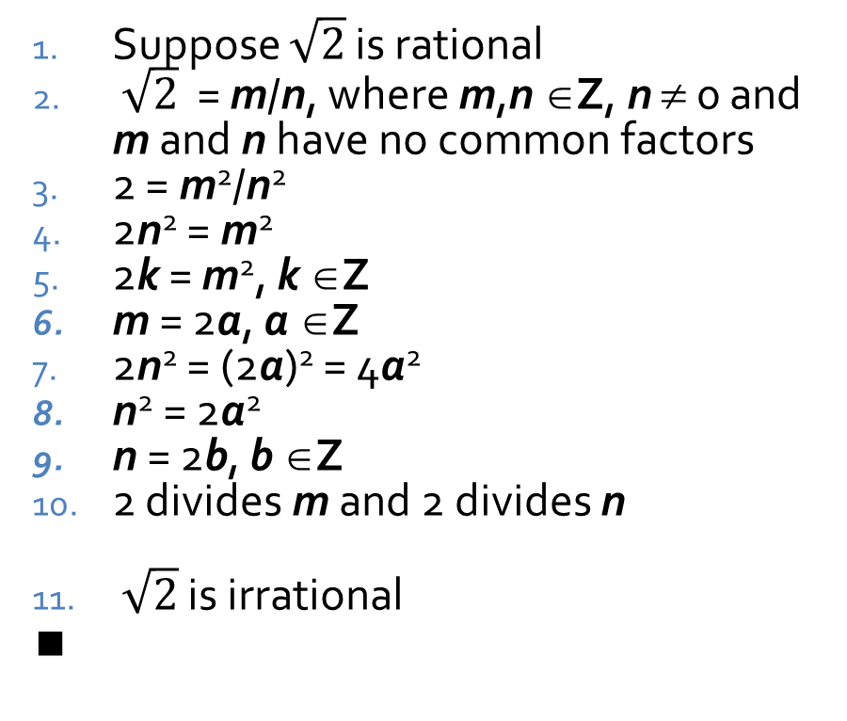
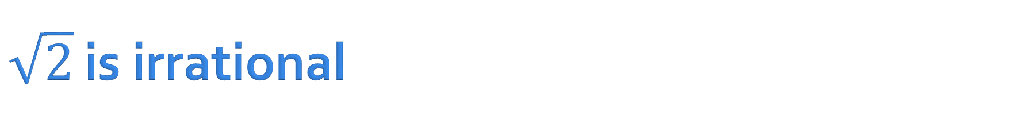
$\sqrt{2}$ is irrational
Theorem: $\sqrt{2}$ is irrational
Proof by contradiction:
Suppose $\sqrt{2}$ is rational
$\sqrt{2}$ = m/n, where m,n ∈Z, n ≠ 0 and m and n have no common factors
2 = m²/n²
2n² = m²
2k = m², k ∈Z
m = 2a, a ∈Z
2n² = (2a)² = 4a²
n² = 2a²
n = 2b, b ∈Z
2 divides m and 2 divides n
$\sqrt{2}$ is irrational
∎
Negation of conclusion
Definition of rational
Squaring both sides
Multiply both sides by n²
Square of integer is integer
Even x² implies even x (Proven elsewhere)
Substitution
Transitivity
Even x² implies even x
Conjunction of 6 and 9, contradiction
By contradiction in 10, supposition is false

Slide 31
Three-sentence Summary of Computational Tractability and Asymptotic Orders of Growth

Slide 32
Computational Tractability

Slide 33
Why polynomial time?
Algorithm designers often consider any algorithm that runs in polynomial time to be "efficient"
  Obviously untrue for n¹⁰⁰
In practice, most polynomial time algorithms have reasonable exponents
  And few non-polynomial algorithms run in reasonable time
All polynomial running times have the property that doubling the input size will increase the work by some constant tied to the highest degree of the polynomial
  Doubling in a quadratic takes 4 times as much work
  Doubling in a cubic takes 8 times as much work

Slide 34
Table of running times
Time to do the number of instructions given based on a machine that can do one million instructions per second
 | n | n log n | n² | n³ | 1.5^{n} | 2^{n} | n!
10 | < 1 s | < 1 s | < 1 s | < 1 s | < 1 s | < 1 s | 4 s
30 | < 1 s | < 1 s | < 1 s | < 1 s | < 1 s | 18 minutes | 10²⁵ years
50 | < 1 s | < 1 s | < 1 s | < 1 s | 11 minutes | 36 years | ∞
100 | < 1 s | < 1 s | < 1 s | 1 s | 12,892 years | 10¹⁷ years | ∞
1,000 | < 1 s | < 1 s | 1 s | 18 minutes | ∞ | ∞ | ∞
10,000 | < 1 s | < 1 s | 2 minutes | 12 days | ∞ | ∞ | ∞
100,000 | < 1 s | 2 s | 3 hours | 32 years | ∞ | ∞ | ∞
1,000,000 | 1 s | 20 s | 12 days | 31,710 years | ∞ | ∞ | ∞
For the purposes of this table, we will mark any value greater than 10²⁵ years with ∞. Note that the age of the universe is less than 1.4 x 10¹⁰ years

Slide 35
Upcoming

Slide 36
Next time…
Stable Marriage
Five representative problems:
  Interval scheduling
  Weighted interval scheduling
  Bipartite matching
  Independent set
  Competitive facility location

Slide 37
Reminders
Read Sections 1.1 and 1.2
Assignment 1 is due next Friday

